Slide 1

Final Project Presentation
Reza Marzban
Oklahoma State University

Slide 2

Introduction
Dataset: Diabetes 130-US hospitals for years 1999-2008 Data Set
(102,000 records and 50 columns)
Phase1: create regression models on time on hospital
Phase 2: create classification models on change in medication

Slide 3
Preprocessing
We spent 70% of our time in our preprocessing step.
Handled missing values.
Created one-hot encoder for nominal data.
Reduced the layers of diagnosis in diag1, diag2 and diag3 (see next slide).
Normalized features.
Split data into train set and test set with ratio of 80:20.

Slide 4
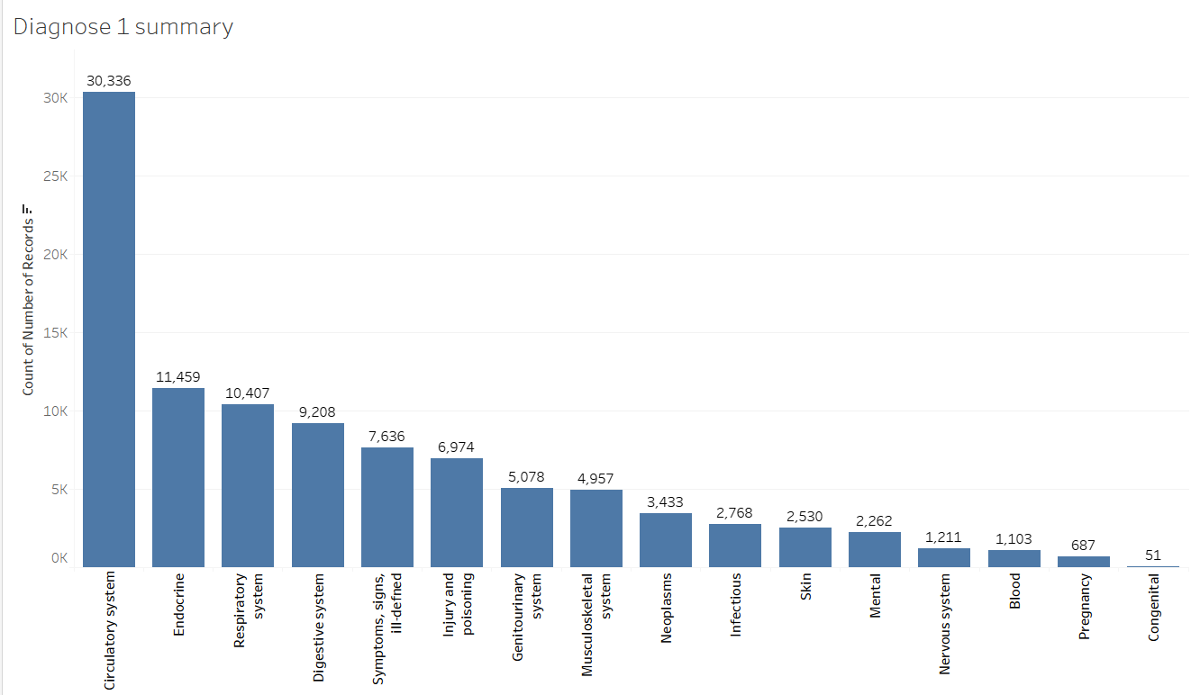
Preprocessing (cont.)
Diagnosis columns had ICD-9 codes as values and there were around 960 such unique levels (for 960 different diseases). We reduced them to 19 categories.

Slide 5
Regression
In our regression, target was time in hospital.
We started with all independent variables and dropped all except significant IVs.
The most important IVs: age, num_lab_procedures, num_medications
The final regression performance is shown in next slide.

Slide 6
Regression (cont.)
Our final Multi linear regression had 25 independent variables.
Score Name | Training set | Test Set
R_Square | 0.301 | 0.305
Mean Absolute Error | 1.898 | 1.889
Mean Squared Error | 6.241 | 6.176
Root Mean Squared Error | 2.498 | 2.485
Mean Signed Difference | -1.458 | -0.013
Mean absolute percentage Error | 0.665 | 0.663

Slide 7
Classification
In our classification the target is Change in medication.
We implemented and compared four different algorithms:
Naïve Bayes, Decision Tree, Logistic Regression, Artificial Neural Networks
We fitted all on train set and evaluated their performance on test set.

Slide 8
Classification (cont.)
 | Accuracy | Recall | Precision | F-measure | Area Under Curve
Naïve Bayes | 54.20% | 00.10% | 100.00% | 00.10% | 0.7730
Decision Tree | 66.30% | 63.30% | 63.30% | 63.30% | 0.7018
Logistic Regression | 71.90% | 84.66% | 61.10% | 73.40% | 0.8018
Artificial Neural Network | 72.30% | 84.74% | 65.20% | 73.70% | 0.8029
It can be seen that ANN is the best model.

Slide 9
Classification (cont.)

Slide 10
Classification (cont.)
Artificial Neural Network Confusion Matrix:
Artificial Neural Network Confusion Matrix |  | Predicted
 |  | Change | No_Change
Actual | Change | 7907 (TP) | 1423 (FN)
 | No_Change | 4215 (FP) | 6809 (TN)

Slide 11
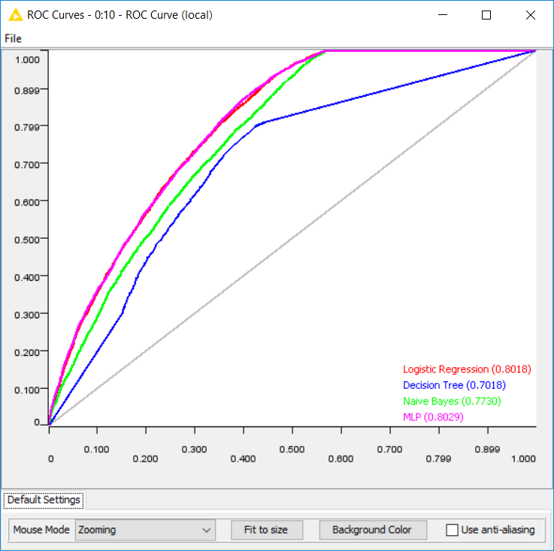
ROC curve and AUC

Slide 12
Conclusion
The most important IVs in our classification models: diabetesMed, num_medication
Both our hypothesizes are true but in our classification problem there is a much more strong correlation.
we recommend that patients that are using diabetic medications and the number of their medication usage daily are high, must visit their hospital to update their prescription more frequently.

Slide 13
Future Work
Applying the approaches mentioned in this study on different diseases.
Bringing up deep learning models with time series aspect like using Recurrent Neural Networks (RNNs) and Long-Short Term Memory (LSTM)

